Slide 1
Chapter 7: Cubic 4-ordered Hamiltonian and 4-ordered Hamiltonian connected/laceable graphs

Slide 2
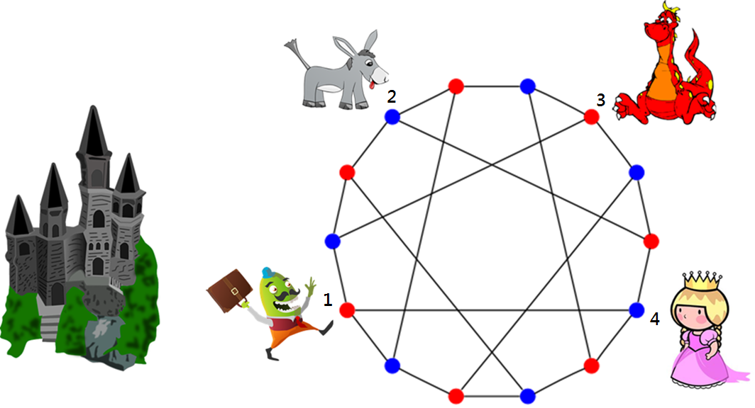
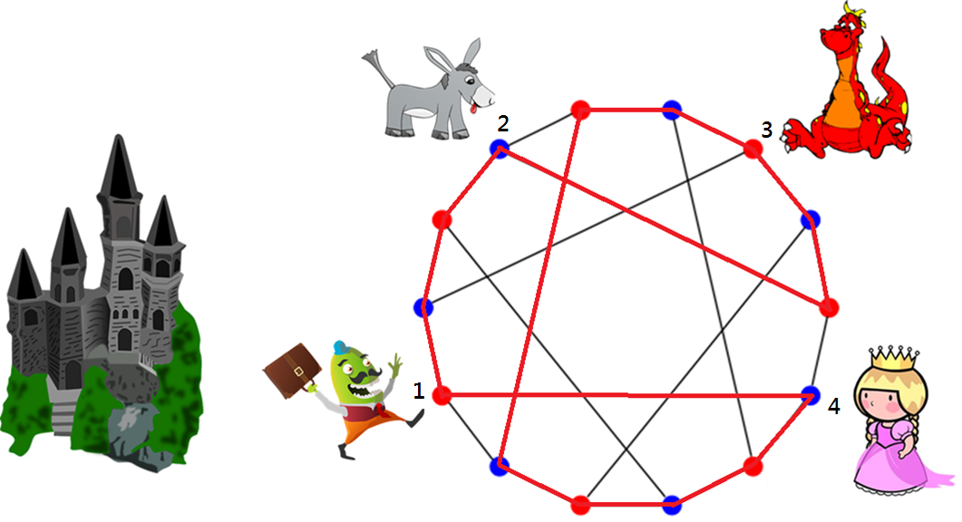
Heawood

Slide 3
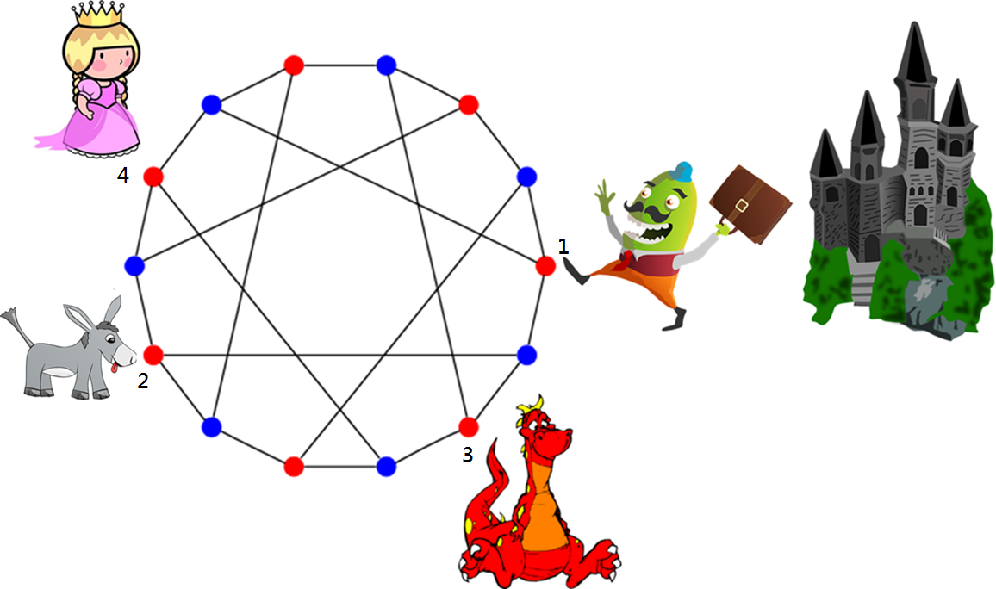

Figure 7-4

Slide 4
Cubic 4-ordered hamiltonian
Generalization: k-ordered hamiltonian
Why

Slide 5
Any Hamiltonian graph is 3-ordered Hamiltonian.

Slide 6
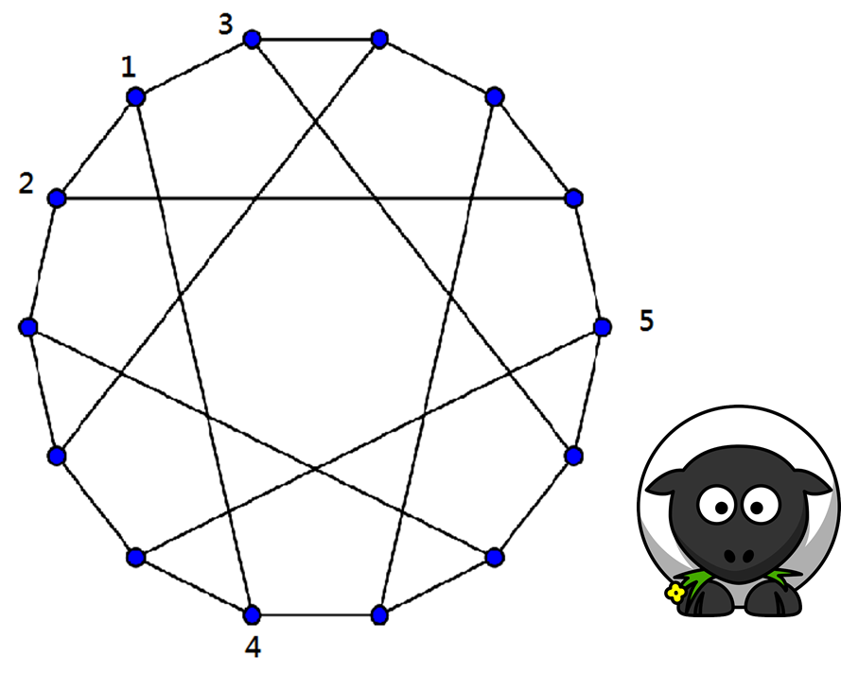
Not 5-ordered hamiltonian

Slide 7
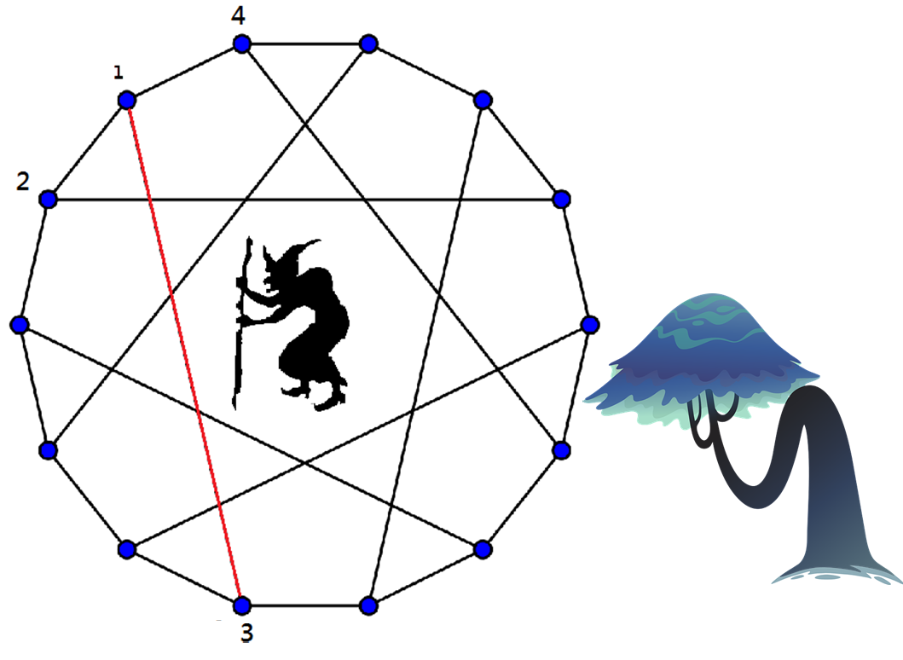
Every cubic 4-ordered Hamiltonian graph is 1-edge fault Hamiltonian.
Figure 7-6

Slide 8
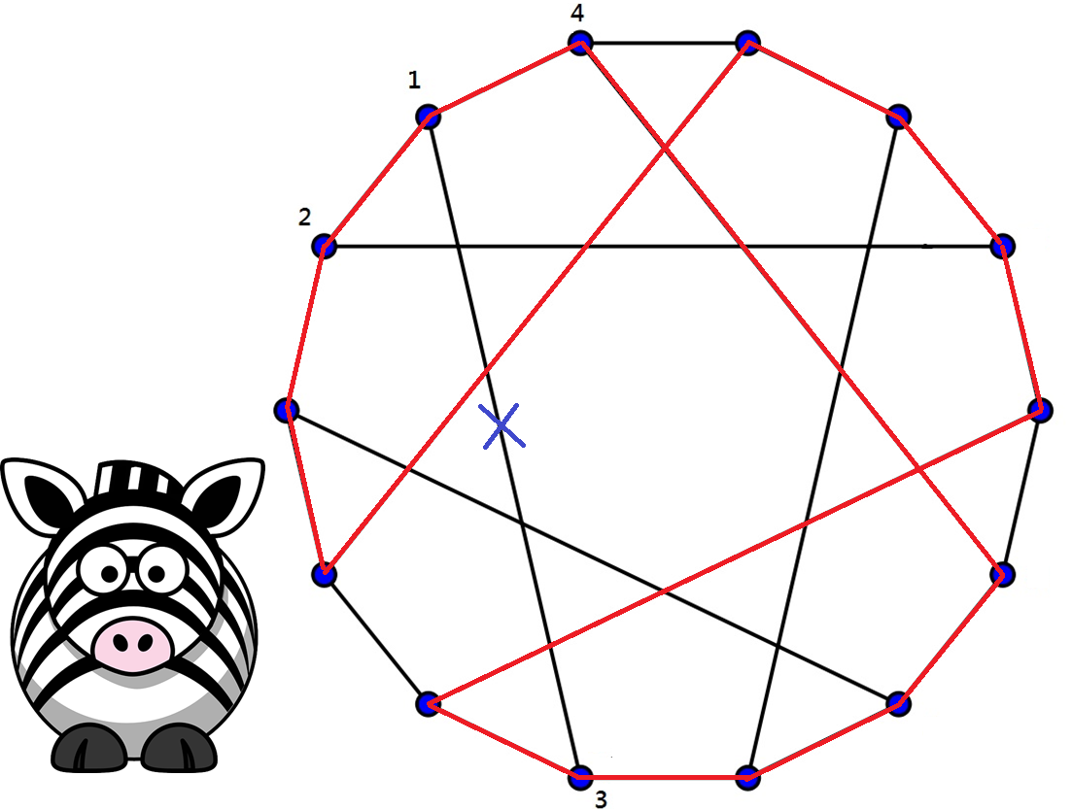
Figure 7-7

Slide 9
Other examples?

Slide 10
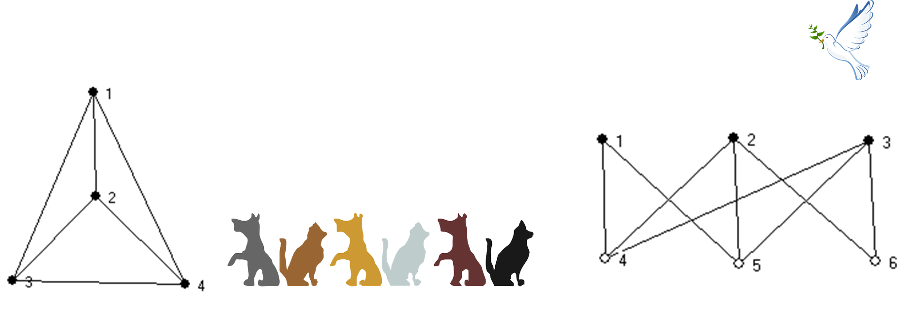
K_{3,3}
K₄
Figure 7-8
Figure 7-9

Slide 11
The concept of cubic 4-ordered Hamiltonian graphs was proposed in 1997 [4]. These two graphs were proposed as examples. The authors challenged their readers to find more examples of cubic 4-ordered Hamiltonian graphs. The graph of the Kingdom Far-Far Away is actually only the third ever cubic 4-ordered Hamiltonian graph found, in 2008 [3]. This graph is also known as the Heawood graph. Later, we will give you more examples of cubic 4-ordered Hamiltonian graphs. However, we must first present some examples of cubic graphs that are not 4-ordered Hamiltonian.

Slide 12
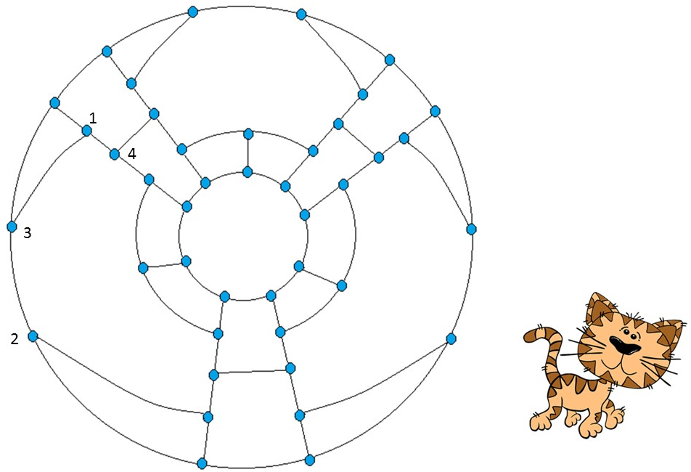
Girth > 3
x
Figure 7-10

Slide 13
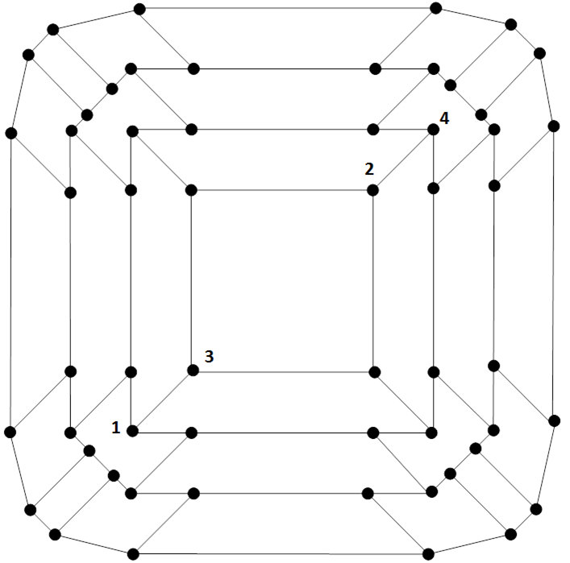

Girth > 4
x
y
Figure 7-11

Slide 14
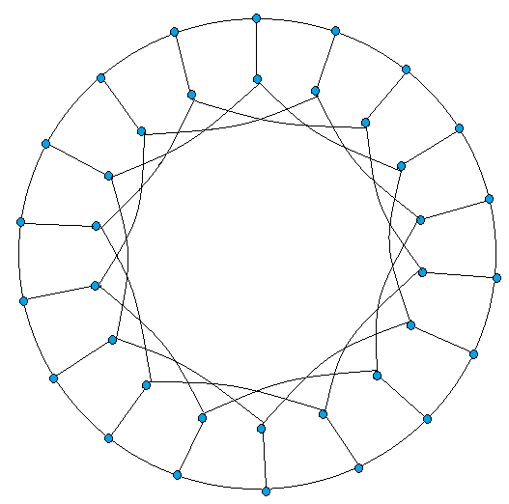

The following few graphs are a list of cubic 4-ordered Hamiltonian graphs.
GP(18;3)
Figure 7-12

Slide 15

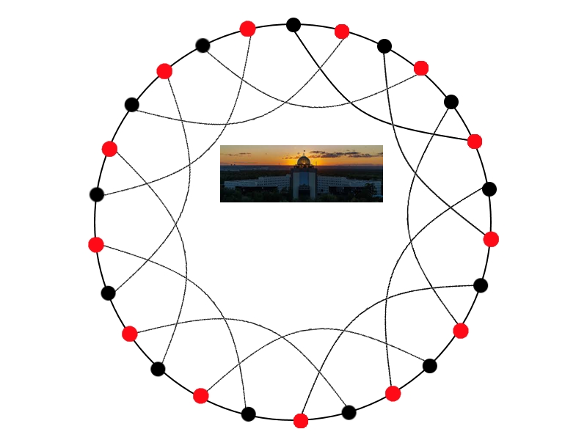
CR(26,1,5)
Figure 7-13

Slide 16
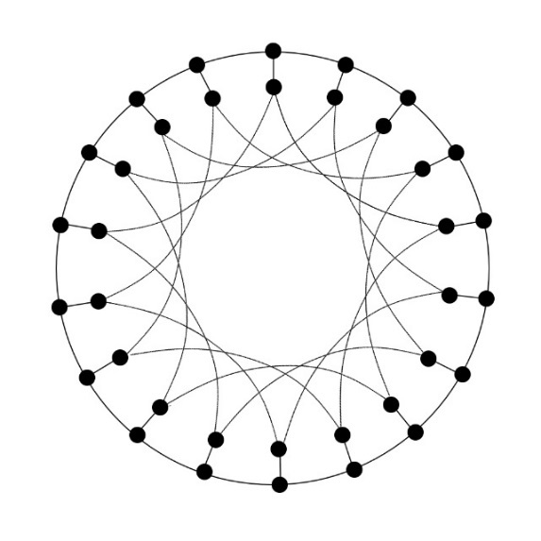
GP(18,4)
Figure 7-14

Slide 17


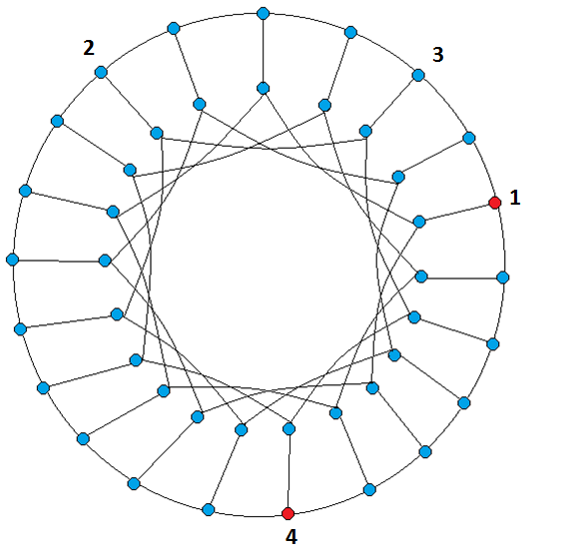


4-ordered Hamiltonian connected
3
3
2
GP(21,4)
Figure 7-15

Slide 18
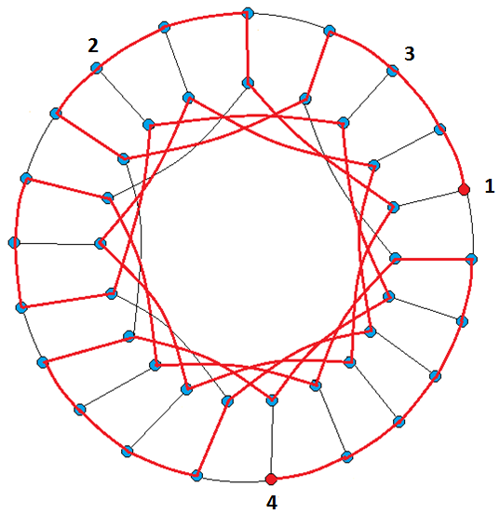

3
2
Figure 7-16

Slide 19

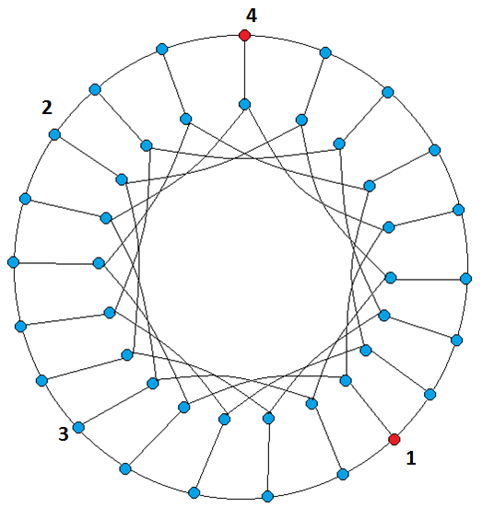

3
2

Slide 20

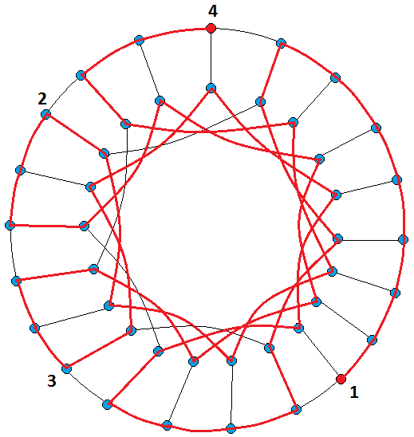
3
2
Figure 7-18

Slide 21
cubic 4-ordered Hamiltonian connected graphs.
We can generalize this concept as k-ordered Hamiltonian connected graphs, meaning that for any given k vertices there exists a Hamiltonian path beginning with the first vertex, ending with the last vertex, and passing through the required vertices in the order desired.

Slide 22
Any Hamiltonian connected graph is 3-ordered Hamiltonian connected.

Slide 23
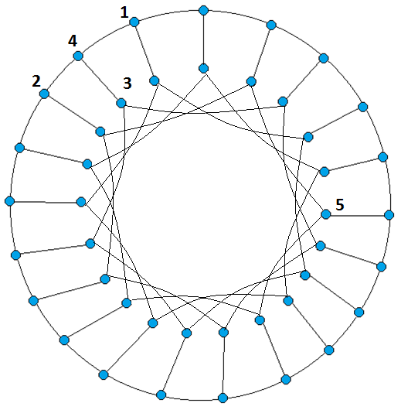

Not 5-ordered hamiltonian connected
Figure 7-19

Slide 24
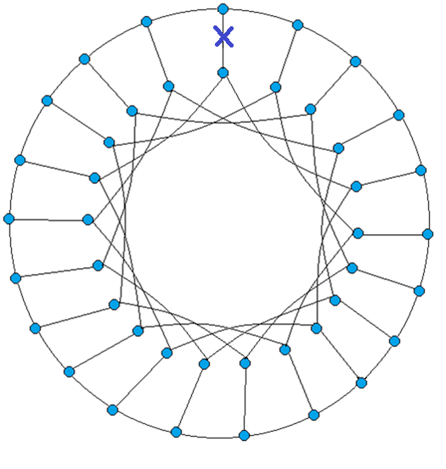

1-edge fault tolerant Hamiltonian
Figure 7-20

Slide 25
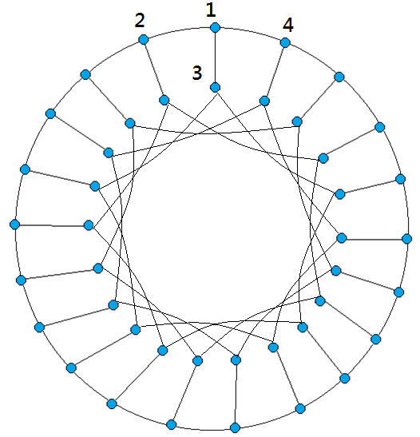
Figure 7-21

Slide 26
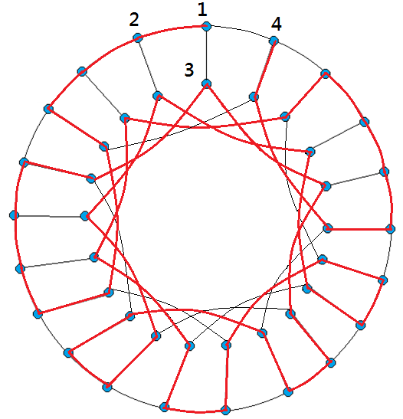

Slide 27
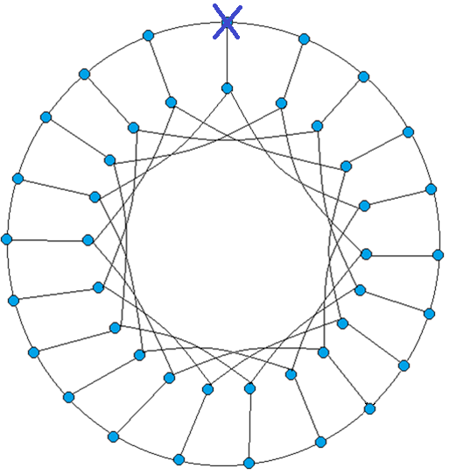
Not 1-vertex fault tolerant hamiltonian

Slide 28
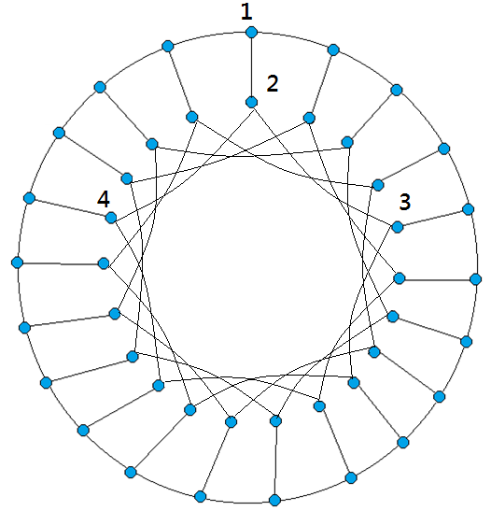

Slide 29
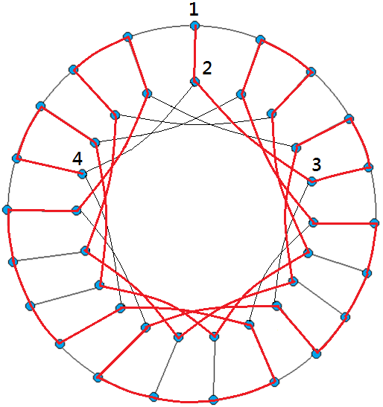

Slide 30
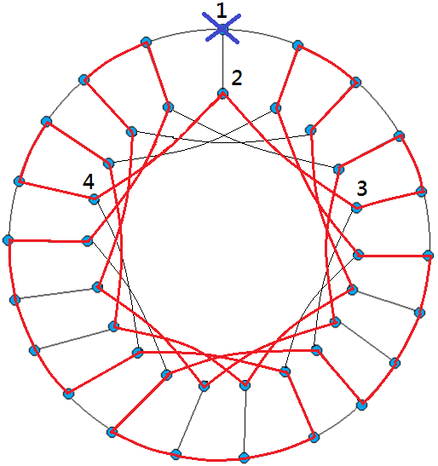

Slide 31
Again, finding cubic 4-ordered Hamiltonian connected graphs is not an easy job. We have seen one example in the map of Wizard Land. There is another example, namely, K₄.
It is interesting to note that the shortest cycle in any cubic 4-ordered Hamiltonian connected graph with at least seven vertices is five or greater. The proof is virtually identical to the one used for cubic 4-ordered Hamiltonian graphs.

Slide 32
Girth > 3
x
Figure 7-27

Slide 33
Girth > 4
Figure 7-28

Slide 34
The following are some other examples of cubic 4-ordered Hamiltonian connected graphs.

Slide 35
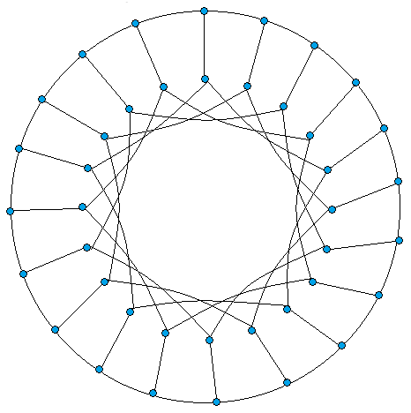
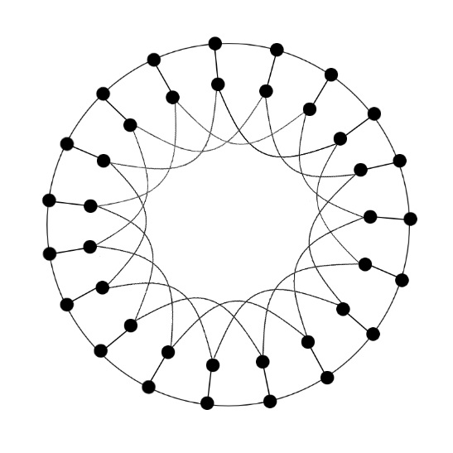


GP(19,3)
Figure 7-29
Figure 7-30
GP(20;4)

Slide 36
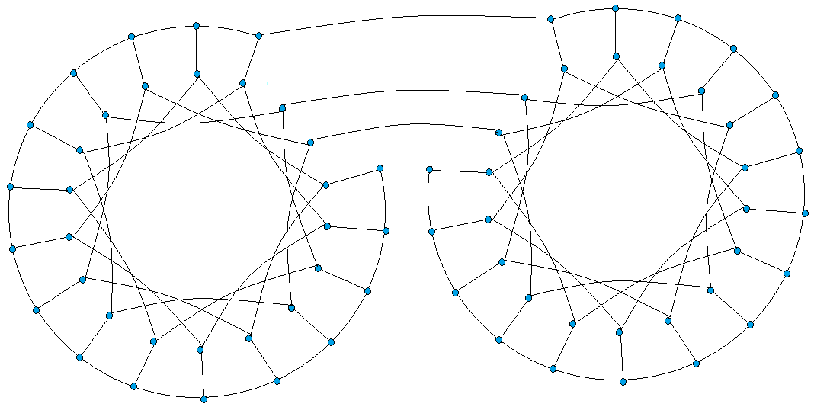


Edge join
Figure 7-31

Slide 37
4-ordered Hamiltonian laceable

Slide 38
K_{3,3} is cubic 4-ordered Hamiltonian laceable.
Yet, the graph of the Kingdom Far-Far-Away is bipartite. However it is not 4-ordered Hamiltonian laceable.
Other 4-ordered Hamiltonian laceable graphs

Slide 39
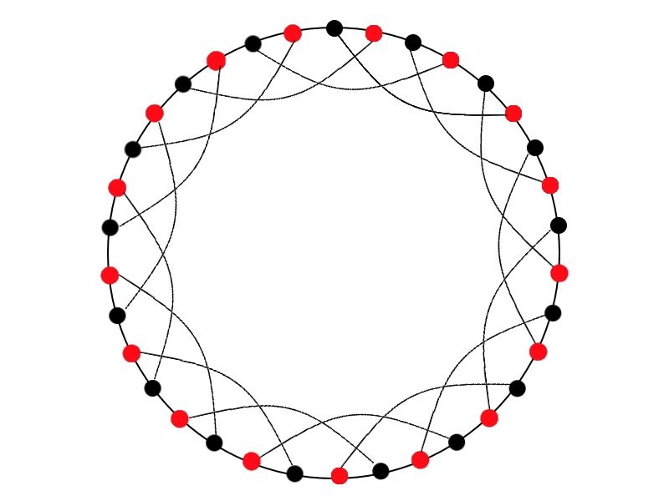

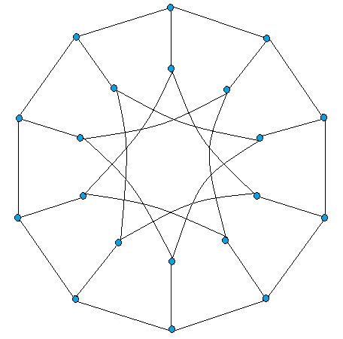


GP(10,3)
CR(34,1,5)
Figure 7-33
Figure 7-32

Slide 40
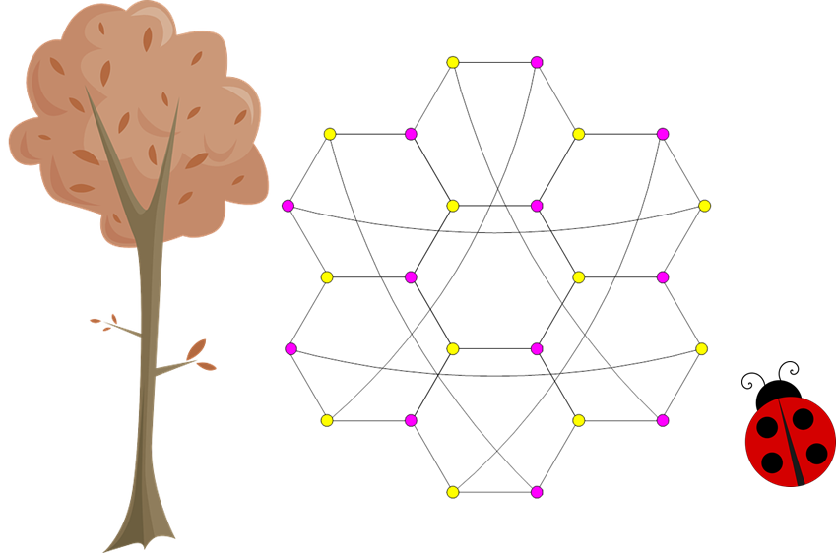
HT(2)
Figure 7-34

Slide 41
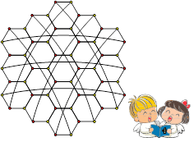
HT(3)

Slide 42
Suggested Reading and Possible Future Directions
In 1997, two strong Hamiltonian properties were introduced by Ng and Schultz [4]. A graph is k-ordered Hamiltonian if for every k ordered set S = {x₁,x₂,…, x_{k}} there exists a Hamiltonian cycle which encounters S in its designated order. Moreover, a graph is k-ordered Hamiltonian connected if for every k ordered set S = {x₁,x₂,…, x_{k}} there exists a Hamiltonian path joining x₁ to x_{k} that encounters S in its designated order.

Slide 43
Obviously, any Hamiltonian graph is 3-ordered Hamiltonian. Thus, the k-ordered Hamiltonian property is really interesting only for k≥4. Similarly, any Hamiltonian connected graph is 3-ordered Hamiltonian connected. Again, the k-ordered Hamiltonian property is really interesting only for k≥4.

Slide 44
Ng and Schultz [4] proposed the question of the existence of cubic 4-ordered Hamiltonian graph other than K₄ and K_{3,3} and the existence of cubic 4-ordered Hamiltonian connected graphs other than K₄. In 2008, Meszaros [3] proved that the Heawood graph is 4-ordered Hamiltonian.

Slide 45
Then, Hsu et. al. [1] classified those generalized Petersen graphs GP(n; 3) as 4-ordered Hamiltonian. It was proven that the generalized Petersen graph GP(n; 3) is 4-ordered Hamiltonian if and only if n is even and either n = 18 or n ≥24. Thus, there exists an infinite number of 3-regular 4-ordered Hamiltonian graphs.

Slide 46
Since the existence of cubic 4-ordered Hamiltonian graphs seems very rare, we are wondering these graphs must by very symmetric. A graph is vertex-transitive if every vertex has the same local environment, so that no vertex can be distinguished from any other based on the vertices and edges surrounding it. Similarly, A graph is edge-transitive if every edge has the same local environment, so that no edge can be distinguished from any other based on the vertices and edges surrounding it.

Slide 47
Note that GP(n; 3) is vertex transitive if and only if n = 8 or n = 10. Can we find an infinite number of 3-regular vertex transitive 4-ordered Hamiltonian graphs? Sherman et. al. [5] answer the question affirmatively by considering a family of graphs which is a generalization of the Heawood graph.

Slide 48
The Chordal Ring graph, denoted by CR(2n; 1; k) with 3 ≤ k ≤ n, is a graph with its vertex set {v_{i} | 0 ≤ i < 2n} and edge set {(v_{i},v_{i+1}) | 0 ≤ i < 2n} ∪{(v_{i}, v_{i+k}) |i is even and 0 ≤ i < 2n} where the indices are always taken modulo 2n. Note that the Heawood graph is CR(14; 1; 5). Moreover, any Chordal ring graph is vertex transitive. It was proven that CR(2n; 1; 5) is 4-ordered Hamiltonian if and only if 2n = 12k+2 or 2n = 12k+10 for some k≥2 or 2n = 14.

Slide 49
Now, let us discuss the progress of 4-ordered Hamiltonian connected/laceable graphs. We note that GP(n; 3) is a bipartite graph if n is even. Moreover, CR(2n; 1; k) is a bipartite graph if 3≤ k ≤ n. It is interesting to point out in [1] that GP(n; 3) is 4-ordered Hamiltonian laceable if and only if n ≥ 10 and n is even. Thus, GP(n; 3) is 4-odered Hamiltonian laceable but not 4-ordered Hamiltonian if and only if n = 10, 12, 14, 16, 20 and 22.

Slide 50
Now, can we find a 3-regular 4-ordered Hamiltonian connected graphs besides K₄? It was proven [7] that GP(n ; 3) is 4-ordered Hamiltonian connected if and only if n is odd and either n = 15 or n ≥ 19. We note that graphs in this family is 4-ordered Hamiltonian connected but not 4-ordered Hamiltonian.

Slide 51
Hung et al. [8] proved that GP(n; 4) is 4-ordered Hamiltonian if and only if n ≥ 18 and n ≠ 20 and GP(n; 4) is 4-ordered Hamiltonian connected if and only if n ≥ 18. We note that GP(20; 4) is 4-ordered Hamiltonian connected but not 4-ordered Hamiltonian.

Slide 52
We note that GP(n; 4) is vertex transitive if and only if n is 15 or 17. Thus, K₄ is the only known vertex transitive graph that is both 4-ordered Hamiltonian and 4-ordered Hamiltonian connected. So, the next step is to find a non-trivial vertex transitive graph that is both 4-ordered Hamiltonian and 4-ordered Hamiltonian connected.

Slide 53
Using a computer, we can prove that CCC₅ is both 4-ordered Hamiltonian and 4-ordered Hamiltonian connected. Moreover, HM(n) is both 4-ordered Hamiltonian and 4-ordered Hamiltonian laceable for n = 1 and 3.

Slide 54
In mathematics, one example "solves the existence problem." Yet, it may be a unique solution, many but finite solutions, or an infinite number of solutions. We wonder if there are an infinite number of 3-regular vertex transitive graphs that are 4-ordered Hamiltonian and 4-ordered Hamiltonian connected. More precisely, we hypothesize that any CCC_{n} with n is odd and n ≥ 5 is 4-ordered Hamiltonian and 4-ordered Hamiltonian connected. Furthermore, any CCC_{n} with n is even and n ≥ 6 is 4-ordered Hamiltonian and 4-ordered Hamiltonian laceable. Similarly, we hypothesize that HM(n) is 4-ordered Hamiltonian and 4-ordered Hamiltonian laceable for any positive integer when n ≠ 2. Yet, we hypothesize that there are no cubic vertex transitive and edge transitive graphs that are 4-ordered Hamiltonian and 4-ordered Hamiltonian connected other than K₄.

Slide 55
So far, we have seen several examples of cubic 4-ordered Hamiltonian connected but not 4-ordered Hamiltonian graphs. We hypothesize that there are an infinite number of such graphs. Similarly, we have several examples of cubic 4-ordered Hamiltonian laceable but no 4-ordered Hamiltonian graphs. We hypothesize that there are infinite number of such graphs.

Slide 56
We note that the Heawood graph, CR(14; 1; 5), is the only known 3-regular bipartite graph that is 4-ordered Hamiltonian but not 4-ordered Hamiltonian laceable. The generalized Petersen graph, GP(20; 4), is the only known 3-regular graph that is 4-ordered Hamiltonian connected but not 4-ordered Hamiltonian.
Unique?

Slide 57
Finally, we note the following observation. Using a computer, we can prove that HT(2) is a 3-regular, vertex transitive, edge transitive, and 4-ordered Hamiltonian laceable. However, HT(2) is not 4-ordered Hamiltonian. Note that HT(2) is the only known 3-regular, vertex transitive, edge transitive, and 4-ordered Hamiltonian laceable graph that is not 4-ordered Hamiltonian. We wonder if this graph is "unique" to each of its corresponding families.

Slide 58
References
[1] L.H. Hsu, J.M. Tan, E. Cheng, L. Liptak, C.K. Lin, and M. Tsai, Solution to an Open Problem on 4-Ordered Hamiltonian Graphs, Discrete Mathematics, Vol. 312, (2012) 2356-2370.
[2] C.N. Hung, D. Lu, R. Jia, C.K. Lin, L. Liptak, E. Cheng, and L.H. Hsu, 4-Ordered Hamiltonian Problems of the Generalized Petersen Graph GP(n,4), Mathematical and Computer Modelling, Vol. 57 (2013), 595-601.
[3] K. Meszaros, On 3-regular 4-ordered graphs, Discrete Mathematics, 308 (2008) 2149-2155.

Slide 59
[4] L. Ng, M. Schultz, k-Ordered Hamiltonian Graphs, Journal of Graph Theory 24 (1997) 45-57.
[5] D. Sherman, M. Tsai, C.K. Lin, L. Liptak, E. Cheng, Jimmy J.M. Tan, and L.H. Hsu, 4-Ordered Hamiltonicity for Some Chordal Ring Graphs, Journal of Interconnection Networks, Vol. 11 (2010) 157-174
[6] M. Tsai, T.H. Tsai, Jimmy J.M. Tan, and L.H. Hsu, On 4-Ordered 3-Regular Graphs, Mathematical and Computer Modelling, Vol. 54 (2011) 161-1619.

